Slide 1



QUANTUM COMPUTING AND QUANTUM INTERNET ay 2024 2025
Student
Lorenzo Menchini
Prof.
Luciano Lenzini
Leonardo Baciottini

Slide 2
INDEX
1
2
3
4
SHOR ALGORITHM: PREVIEW
CIRCUIT IMPLEMENTATION
EXPERIMENTAL SETUP
EVALUATION OF IBM QUANTUM COMPUTER AND SIMULATION
RESULTS

Slide 3
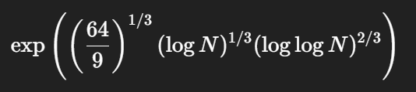

SHOR ALGORITHM
1
1
1
Shor’s Algorithm is a quantum algorithm designed to efficiently factor large integers.
Classical factoring algorithms require exponential time, making factoring hard for very large numbers.
Shor’s Algorithm solves this problem in polynomial time using quantum period finding.
General Number Field Sieve (GNFS)
Shor algorithm
Sub-exponentia complexity
Polinomial complexity

Slide 4
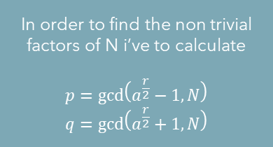


ALGORITHM WORKFLOW
1
1
Choose N
1
Select a
False
1<a<N?
True
q = $\frac{N}{P}$
Factors founded
gcd(a,N) = p≠ 1?
Find period r
Using QPE
False
r even?
False
$$a^{\frac{r}{2}} mod N ≠N −1?$$
In order to find the non trivial factors of N i’ve to calculate
$$p=\gcd\left(a^{\frac{r}{2}}−1,N\right)$$
$$q=\gcd\left(a^{\frac{r}{2}}+1,N\right)$$
Factors founded

Slide 5
Implementing Shor algorithm on Qiskit with N = 21: choose 3 arbitrary values for a (1<a<N) coprime with N and run the algorithm for each value Evaluate on: - a noiseless quantum simulator - a real IBM quantum device Performance metric: average number of quantum period finding shots required to successfully factor N
2
CIRCUIT IMPLEMENTATION:
Project requirements
2

Slide 6
EXPERIMENTAL SETUP
3
Knowing that N=21 means that the working register must be of 5 qubits
The values chosen for the experiment will be a = 2, 10, 19, all of them coprime with N
The phase register has to be at least m = ⌊2log2(N)⌋ qubits, so i choose m = 10
Phase register (m qubits)
Working Register (n qubits)
IQFT circuit
U unitary gate
Measuration for each qubit of the phase register

Slide 7
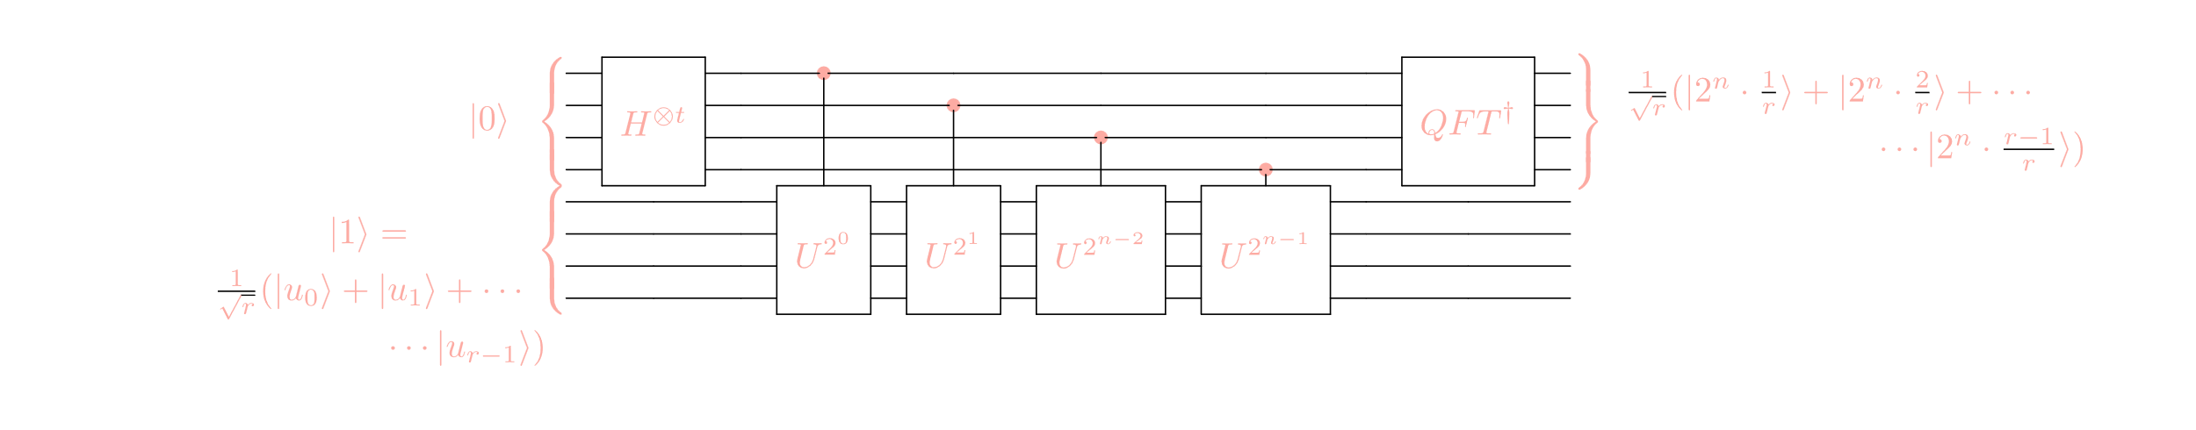
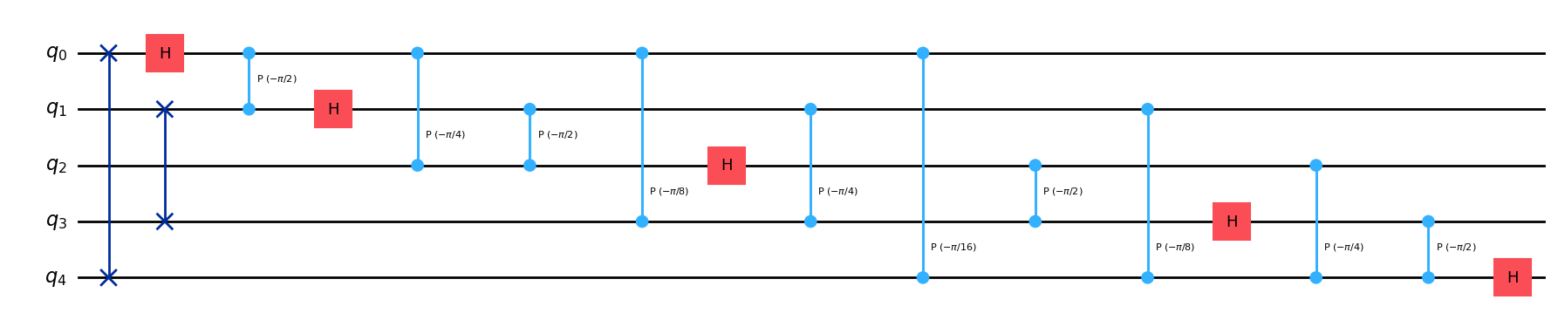
Qiskit circuits
3
2
PHASE ESTIMATION CIRCUIT
IQFT

Slide 8
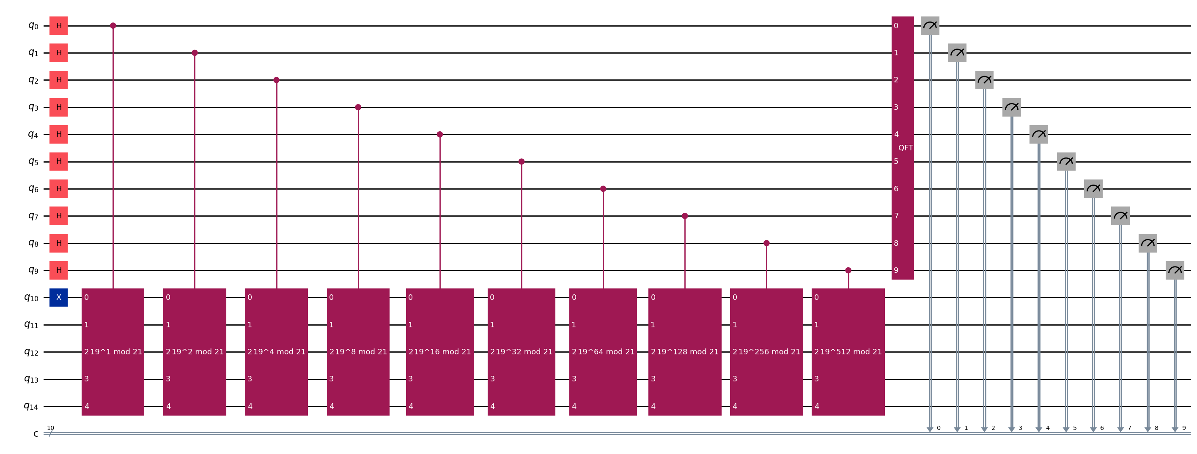



3
QPE CONSTRUCTION
2
In Shor is crucial the period finding, which is done
By appling the quantum phase estimation.
The period r is defined as the smallest r such as:
$| a^{r} mod N$ ⟩ = 1
To find it, we have to construct
- A state with non-zero overlap with the eigenstates of U
(|$v_{s}$⟩)
- A unitary operator U defined by modular multiplication
- A way to approximate the phase φ = r/s
(using continue fraction)
a = 2
a = 10
a = 19

Slide 9


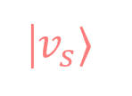
3
|$v_{s}$⟩
We can initialize the input with |1⟩ (e.g., |000...1⟩),
which has nonzero overlap with the eigenstates of Quantum interference and phase kickback
encode the phase of the eigenvalue into the
control register, allowing us to extract r.
U
To build the operator U, I generate a matrix that applies the modular multiplication
$|a^{power}y mod N$ ⟩
acting unitarily only on the valid states y < N.
After measuring the control register,
I obtain a binary string that corresponds to an estimate of the phase φ = r/s.
r period approssimation
Using the continue fraction I can estimate s/r from the phase φ. Firstly I have to check if $\left|\frac{s}{r}−\text{φ}\right|<\frac{1}{2r^{2}}$ and then I can find the convergent of the continuous fraction that fits with s/r (with r<N)

Slide 10
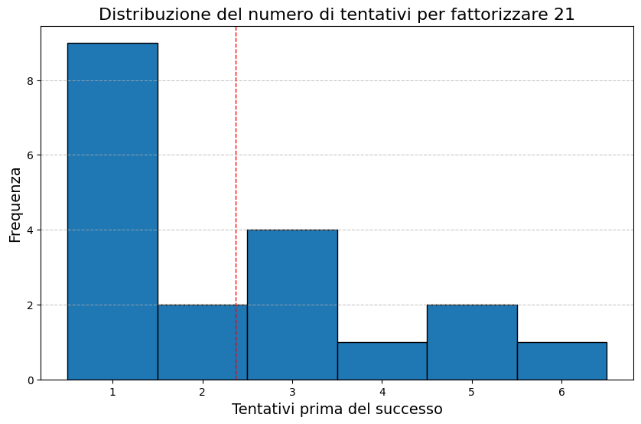
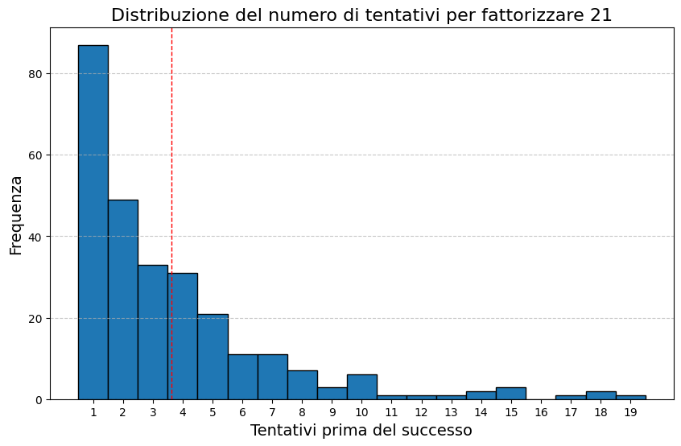




4
EVALUATION
Both for aerSimulation and IBM run we obtained
the period r=6, as we can see:
a=2
$$|a^{k} mod N\text{⟩}$$
$$\text{with} \text{k}\text{ = }1…r$$
2
4
8
16
11
1
a=10
$$|a^{k} mod N\text{⟩}$$
$$\text{with} \text{k}\text{ = }1…r$$
10
16
13
4
19
1
a=19
$$|a^{k} mod N\text{⟩}$$
$$\text{with} \text{k}\text{ = }1…r$$
19
4
13
16
10
1
Which is the smallest number to get $| a^{r} mod N$ ⟩ = 1.
Analyzing the performance difference,
we observe that in simulation the correct factorization is obtained
after an average of 1.8 attempts,
while on IBM Sherbrooke it requires about 3.2
attempts on average, with a worst case of 19

Slide 11
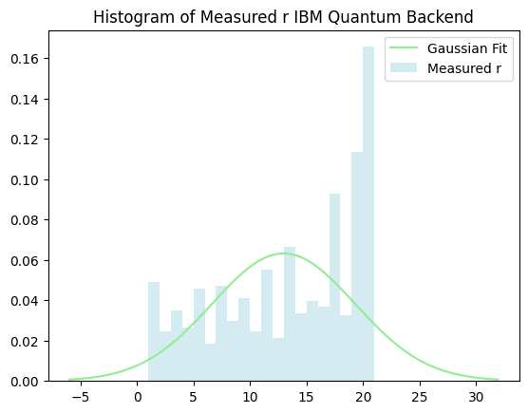
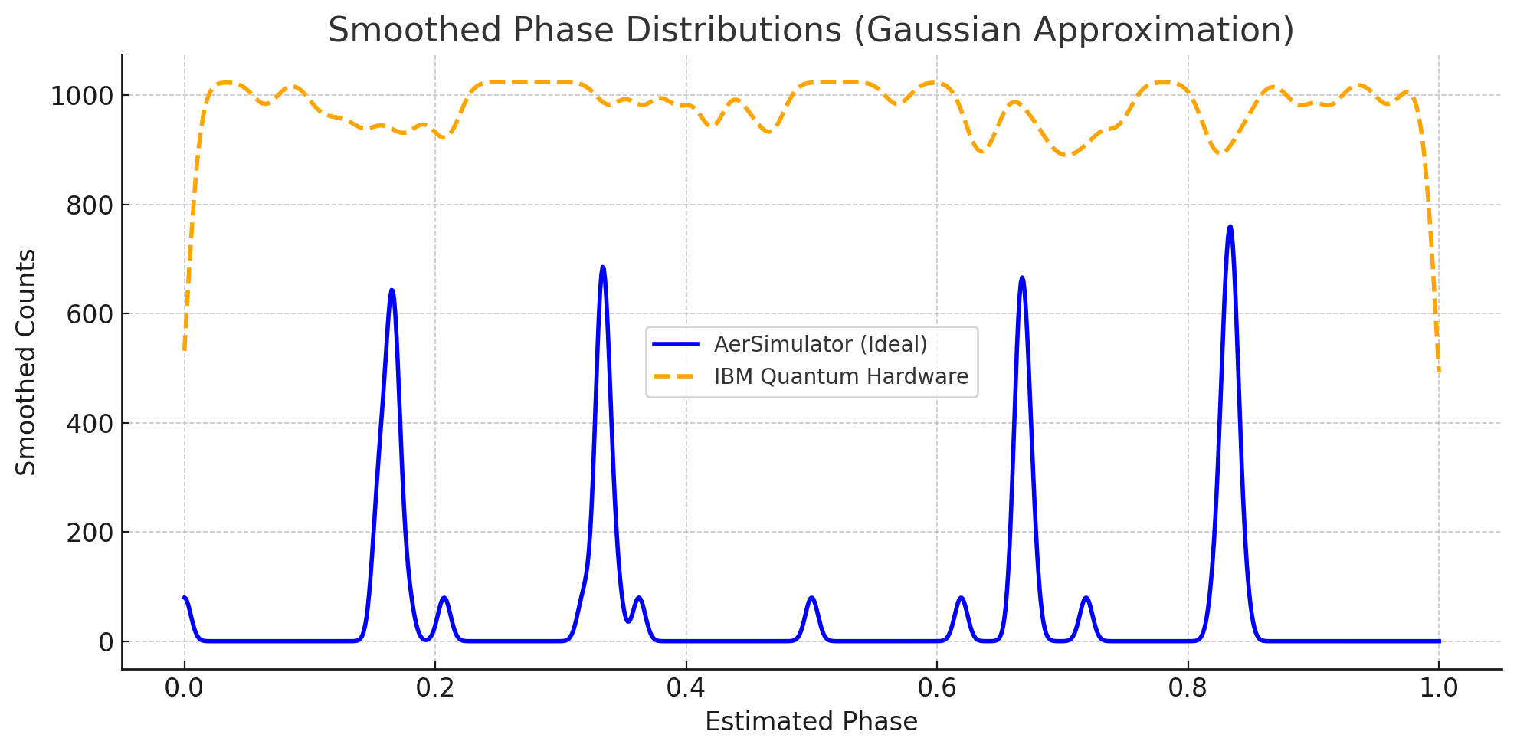
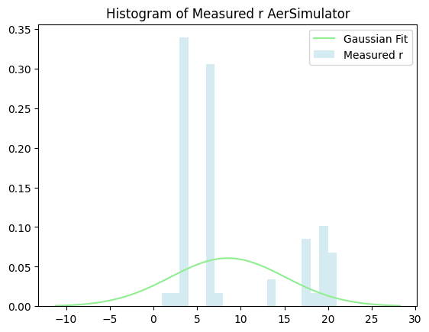
4
EVALUATION
2
In fact, as shown in these graphs,
the variance of the results is significantly different.
In real quantum hardware, performance is affected by several sources of noise:
Decoherence
imperfect gate fidelities
Limited qubit connectivity also leads to additional SWAP gates, increasing circuit depth and error accumulation.
shot noise introduces statistical fluctuations due to finite measurement repetitions. (1024 shots)

Slide 12
2
Thanks for attention

